Slide 1

NATIONAL INSTITUTE OF TECHNOLOGY, RAIPUR
Time Series Analysis
DR. MRIDU SAHU
ASSISTANT PROFESSOR, IT

Slide 2
Definition of time series data Analysis using ML
A time series represents a collection of values obtained from sequential measurements over time. Time-series data mining stems from the desire to reify our natural ability to visualize the shape of data.
Examples of time series analysis in action include:
Weather data
Rainfall measurements
Temperature readings
Heart rate monitoring (EKG)
Brain monitoring (EEG)
Quarterly sales
Stock prices
Automated stock trading
Time Series Data Mining:
1. Time-series data mining stems from the desire to reify our natural ability to visualize the shape of data.
2. The most prominent problems arise from the high dimensionality of time-series data and the difficulty of defining a form of similarity measure based on human perception.

Slide 3
Types of time series analysis
Explanative analysis: Attempts to understand the data and the relationships within it, as well as cause and effect.
Exploratory analysis: Highlights the main characteristics of the time series data, usually in a visual format.
Forecasting: Predicts future data. This type is based on historical trends. It uses the historical data as a model for future data, predicting scenarios that could happen along future plot points.
Intervention analysis: Studies how an event can change the data.
Segmentation: Splits the data into segments to show the underlying properties of the source information.
Even within time series analysis, there are different types and models of analysis that will achieve different results.
Classification: Identifies and assigns categories to the data.
Curve fitting: Plots the data along a curve to study the relationships of variables within the data.
Descriptive analysis: Identifies patterns in time series data, like trends, cycles, or seasonal variation.

Slide 4
Time Series Models
1. Autoregression (AR)
2. Moving Average (MA)
3. Autoregressive Moving Average (ARMA)
4. Autoregressive Integrated Moving Average (ARIMA)
5. Seasonal Autoregressive Integrated Moving-Average (SARIMA)
Autoregression (AR) :
Autoregression is a time series model that uses observations from previous time steps as input to a regression equation to predict the value at the next time step

Slide 5
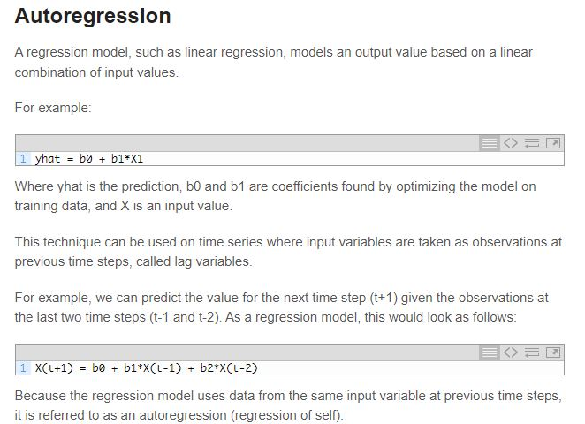

Slide 6
Time series is a sequence of numerical data points in successive order and time series analysis is the technique of analyzing the available data to predict the future outcome of an application. At present, time series analysis has been utilized in a number of applications, including stock market analysis, economic forecasting, pattern recognition, and sales forecasting.
Here is a list of top Python tools, in no particular order, for Time Series Analysis.
Arrow
Arrow is a Python library that offers a human-friendly approach to creating, manipulating, formatting and converting dates, times and timestamps. The library implements and updates the datetime type, plugging gaps in functionality and providing an intelligent module API that supports many common creation scenarios. Features include:
Cesium
Cesium is an open source library that allows users to extract features from raw time series data, build machine learning models from these features, as well as generate predictions for new data. The cesium library also powers computations within the cesium web interface, which allows similar time series analyses to be performed entirely within the browser.

Slide 7
Python tools
PyFlux
TimeSynth
Sktime
Orbit
Pastas

Slide 8
Time Series Data Example : GIS
A geographic information system (GIS) is a computer system for capturing, storing, checking, and displaying data related to positions on Earth’s surface^{[1]}.GIS can help individuals and organizations better understand spatial patterns and relationships.
GIS can use any information that includes location. The location can be expressed in many different ways, such as latitude and longitude, address, or ZIP code.
The power of user-friendly GIS visualization in the form of thematic illustrated maps helps everyone to understand the situation in a better way.
Application of GIS includes mapping, hot-spot analysis, land-information system, urban planning etc.^{[2]}
Prediction of corona virus case is done using time series analysis(Sarima Model).
The SARIMA models are widely used statistical approaches for time-series analysis and forecasting. The non-seasonal ARIMA (p,d,q) method is employed to build the pure seasonal SARIMA (p,d,q)×(P,D,Q)s model^{[3]}.

Slide 9
Spatial Data Mining
Data mining is the automated process of discovering patterns in data.
Spatial data mining is the application of data mining techniques to spatial data with the end objective to find patterns in geography.^{[1]}
The Primitives of Spatial Data Mining:-
RULES- There are several kinds of rules like characteristic rules, discriminant rules, association rules, or deviation and evaluation rules .In this project , we have used characteristic rule for mapping corona cases which is basically a general description of the spatial data^{[2]}.
THEMATIC MAPS- Thematic map is map primarily design to show a theme, a single spatial distribution or a pattern, using a specific map type. These maps show the distribution of features over limited geography area. There are two ways to represent thematic maps: Raster, and Vector .Thematic map that has been used for mapping corona cases is of type vector^{[2]}.

Slide 10
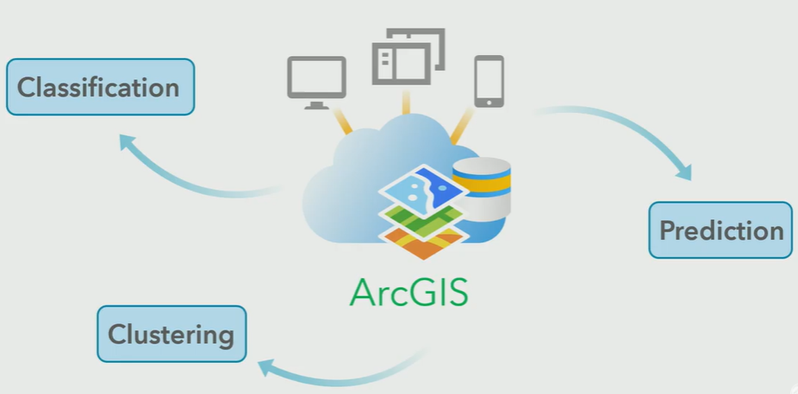
Role of ML in GIS
Machine learning has been a core component of spatial analysis in GIS. These tools and algorithms have been applied to geoprocessing tools to solve problems in three broad categories:
Classification : you can use vector machine algorithms to create land-cover classification layers.
Clustering : lets you process large quantities of input point data, identify the meaningful clusters within them, and separate them from the sparse noise.
Prediction Algorithms : geographically weighted regression, gives you the ability to model spatially varying relationships. ^{[4]}

Slide 11
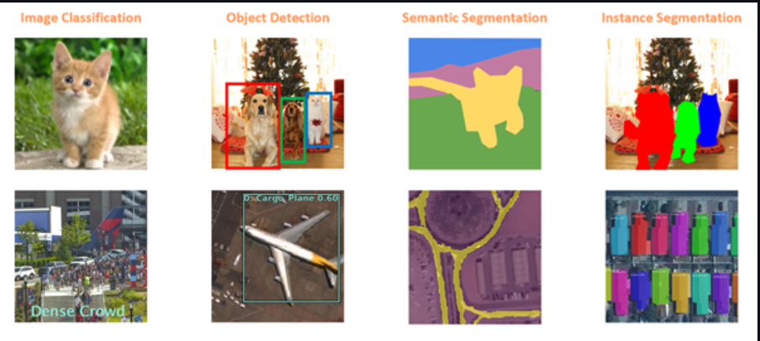
Deep Learning Applications in GIS:
Image Classification: is the simplest method in determining whether a photo is of type A or B. In GIS this can be used to categorize geotagged photos. ^{[4]}
Object Detection: is the method by which a computer manages to find objects within an image by coding them and locating them. In GIS combining this method with satellite imaging, aerial photography, or drone photography can help map objects of interest.^{[4]}
Semantic Segmentation: is a method in which each image pixel is classified to belong to a particular class. In GIS this method can be used for Land Cover Classification.^{[4]}
Instance Segmentation: which is a more precise Object Detection method from which the exact shape of the object found in the image can be extracted. This method can be combined in GIS with LiDAR data to rebuild buildings in 3D. ^{[4]}

Slide 12
Literature Review on
LITERATURE REVIEW
Sr. No. | Authors | Publisher / Year | Method / Advantage | Future Perspective
1 | Yepeng Yao , Wenzhong Shi , Anshu Zhang , Zhewei Liu and Shuli Luo | 2020 | This study collected a comprehensive dataset including a total of 3815 confrmed cases and corresponding locations from January 18 to October 5, 2020. Alinear regression model and Geographically Weighted Regression model were then applied to explore the underlying relationships between COVID-19 cases and the urban BE. ^{[5]} | To find relationship between the spatial confguration of street network and the spread of COVID-19 cases.
2 | Puji Adiatna Nadi , AbdulKader Murad | 2010 | The GIS application in urban transport performance studies consist of seven classifications: accessibility, air pollution (emission), noise pollution, energy consumption, public transport, traffic and road network. This paper shows the use of GIS in Sustainable Urban Transport (SUT) performance is dominantly on traffic and road network studies . ^{[6]} | Promoting and improving the use of GIS in increasing The urban transport sustainability
3 | F. Davis, D. Quattrochi, M. Ridd, N. Lam, S. Walsh | 1999 | Deals with basic scientific issues and research needs in the joint processing of remotely sensed and GIS data for environmental analysis.^{[7]} | TO detect change in geographic pattern to prevent land slide and any other environmental hazards
4 | Hari Shankar Gangwar P.K. Champati Ray | 2020 | Analyses were conducted using geospatial technology at district, state, and country levels, and comparisons were also made with other countries throughout the world that had the highest infection rates^{[8]} | To improve the use of GIS in understanding the trend of corona virus in differently populated areas

Slide 13
Sr. No. | Authors | Publisher / Year | Method / Advantage | Future Perspective
5 | Paolo Burlando, Renzo Rosso, Luis G.Cadavid | 1993 | ARMA model is used for forecasting hourly precipitation at the Denver and Morisson stations. Useful for low-order polynomials (of degree three or less). ^{[9]} | Most effective linear model of stationary time series since they are capable of modeling the unknown process with the minimum number of parameters.
6 | F. Kadri, F. Harrou and Y. Sun | 2017 | A multivariate time series approach to forecasting daily attendances at hospital emergency department(VARMA model) provide more accurate forecast of ED demands than univariate ARMA models. ^{[10]} | In the future, it is intended to improve this model by using more variables, such as CCMU, Arrival mean, and total patient arrival, and other explanatory variables , such as meteorological measurements and epidemic events.
7 | Rahman, Md. Habibur & Salma, Umma & Hossain, Md & Khan, Md Tareq Ferdous. | 2017 | Analysis of seasonal time series data using additive and multiplicative seasonal model of Holt–winters method and forecast the monthly revenue (in crore) using best model—additive Holt–Winters exponential Smoothing. ^{[11]} | Combination of Holt-winters with Neural network could be used to improve the accuracy.
8 | Niematallah Elamin, Mototsugu Fukushige | 2018 | A forecasting framework that employs a seasonal autoregressive integrated moving average model with exogenous variables (main effects) and interaction variables (cross effects) to forecast hourly load demand data. ^{[12]} | the model is built using data for a specific region in Japan, the method is completely generic and therefore applicable to any load forecasting problem.

Slide 14
Sr. No. | Authors | Publisher / Year | Method / Advantage | Future Perspective
9 | Xiaoqian Wanga , Yanfei Kanga , Rob J Hyndmanb , Feng Li | August 2020 | Providing forecasts for ultra-long time series plays a vital role in various activities, such as investment decisions, industrial production arrangements, and farm management. This paper develops a novel distributed forecasting framework to tackle challenges associated with forecasting ultra-long time series by using the industry-standard MapReduce framework. The proposed model combination approach facilitates distributed time series forecasting by combining the local estimators of time series models delivered from worker nodes and minimizing a global loss function. ^{[13]} | To further improve the research on distributed forecastin methods, they suggest some possible research avenues. For example, it would be meaningful to explore distributed ETS models in the future.
10 | Nasim Tohidi, Rustam B. Rustamov | 2020 | Merging GIS and ML offers a potential mechanism to reduce the cost of analysis of spatial information by decreasing the amount of time spent on data interpretation. This integration allows the interpretive outcome from a small area to be transferred to a larger, geographically similar area, without the extra time and expense of putting geographers in the field for a time sufficient to cover geographical area. ^{[4]} | The real potential of ML in GIS is not sufficiently developed yet. On one hand, both fields intersect in analytical discussions. At the same time, most GIS applications which are desirable for ML implementation, are driven by conventional approach and standard tools of commercial GIS packages.
11 | Franch-Pardo, Ivan; Napoletano, Brian M.; Rosete-Verges, Fernando; Billa, Lawal | 2020 | This work is an addition to recent reviews on COVID-19 that offers a geographical perspective. It is a compendium that identifies the themes and analyses that are being carried out with GIS and spatial-statistical tools. ^{[14]} | Understanding the spatial-temporal dynamics of COVID-19 is critical to its mitigation, which is why such work is being done in all regions of the world. This is due in large part to the opening up of large volumes of information by public institutions, international organizations and private companies with geospatial information.

Slide 15
ISSUES AND CHALLENGES
Selection and representation of data for mining from geodatabases due to wide range of file formats^{[1]}.
Understanding of information represented in files ^{[2]}.
Selection and Transformation of spatial attributes from Non spatial Attributes^{[1]}.
The data which are stationary only that can be used for time series analysis^{[3]}.
The ACF and PACF plots should have some inverting lines and should be the defined range for choosing the parameters in Sarima Model^{[4]}.

Slide 16
MOTIVATION
Understanding the Impact of COVID in India.
Need of Data Representation
Understanding the trend of Covid so as to take preventive measures accordingly.
Forecasting of future cases to take precautionary steps.
Rising Cases of Covid.

Slide 17
OBJECTIVES OF THE WORK
To Study and Understand about Spatial Data Mining.
To Study about GIS and its application.
Using GIS and Spatial data mining to map Corona Virus Cases. ^{[4]}
To analyse corona cases by finding if clustering and hotspot is present.
Prediction of Corona virus cases.

Slide 18
DATASET DESCRIPTION
The aim of this research is to map ,analyze and future forecasting the COVID-19 spread focusing on the total number of active cases in India ^{[17]}.
The data set used for the study is retrieved from site^{[18]} which provide
details about active cases, total cases , deaths ,cured , date , region.
The shapefile of India is used to for getting spatial location of various states from site^{[19]}.
The columns in our dataset is 6 and row is 20367.
There is no condition for acquisition of data . It is freely available to use and download.

Slide 19
Online Database Repositories
GLOBAL DATABASES
INDIA'S DATABASE
NAME | DESCRIPTION
Natural Earth | Public domain vector and raster dataset.Supported by the NACIS.^{[1]}
UNEP Environmental data Explorer. | Includes global forest cover, global potential evapotranspiration, global average monthly temperatures, dams, watershed boundaries, and much more. Use the advanced search to select geospatial data sets.^{[2]}
Global Rural-Urban Mapping Project (GRUMP) | Dataset from NASA's Socioeconomic Data and Applications Center (based on the above data, but includes information on rural and urban population balances).^{[1]}
NAME | DESCRIPTION
Open data archive | Bhuvan - GIS - Open Data Archive from NRSC.^{[2]}
Geo-Platform of ISRO | IBhuvan - an Indian Geo-platform of ISRO by National Remote Sensing Centre (NRSC).^{[2]}

Slide 20
Tools and Technologies Used
PROGRAMMING LANGUAGE USED PYTHON
LIBRARIES USED
Pandas is a software library written for the Python programming language for data manipulation and analysis
Geo Pandas is an open source project to make working with geospatial data in python easier. Geo Pandas extends the datatypes used by pandas to allow spatial operations on geometric types.
SOFTWARE USED
Spyder is an open-source cross-platform integrated development environment (IDE) for scientific programming in the Python language.
ARCGIS Online is a cloud-based mapping and analysis solution. It is used to make maps, analyze data.

Slide 21
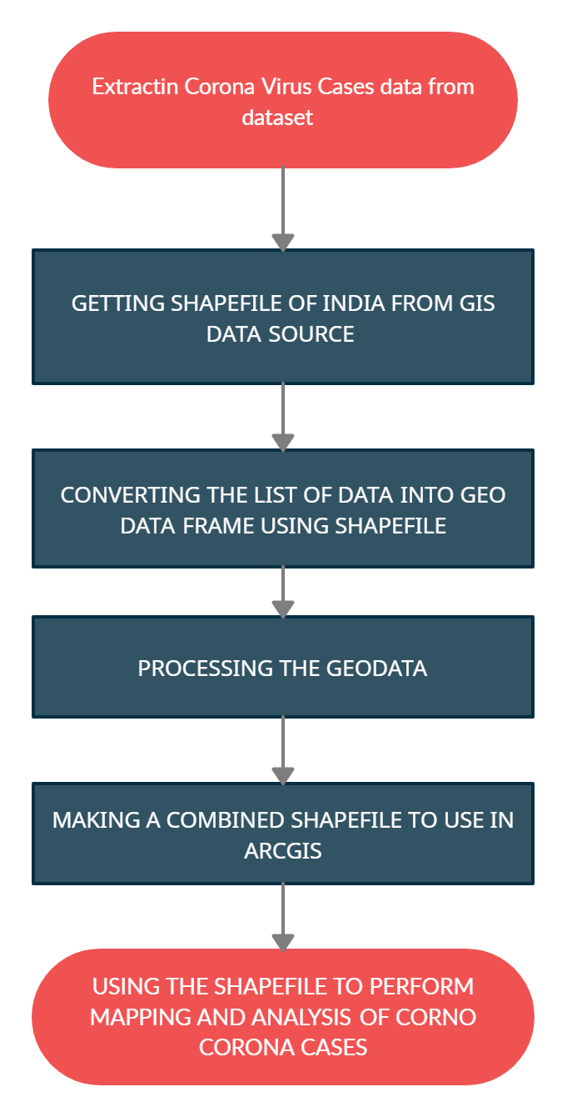
Proposed Method for Mapping and Analyzing Corona Cases using GIS
DATA PREPARATION-
This step involves the preparation of geodatabase of all the states of INDIA.
Firstly state-wise daily data from march 2020 , containing details of total cases , active cases ,recovered cases and deaths is being downloaded from site.
The data obtained is of type list, for spatial analysis this needs to be converted to geodataframe.
The shapefile of India is obtained from GIS data source and the list of data is being converted to geodata using this shape file.
Then a combined shapefile is being created which is used for mapping in ARCGIS and for analysis in Jupyter Notebook

Slide 22
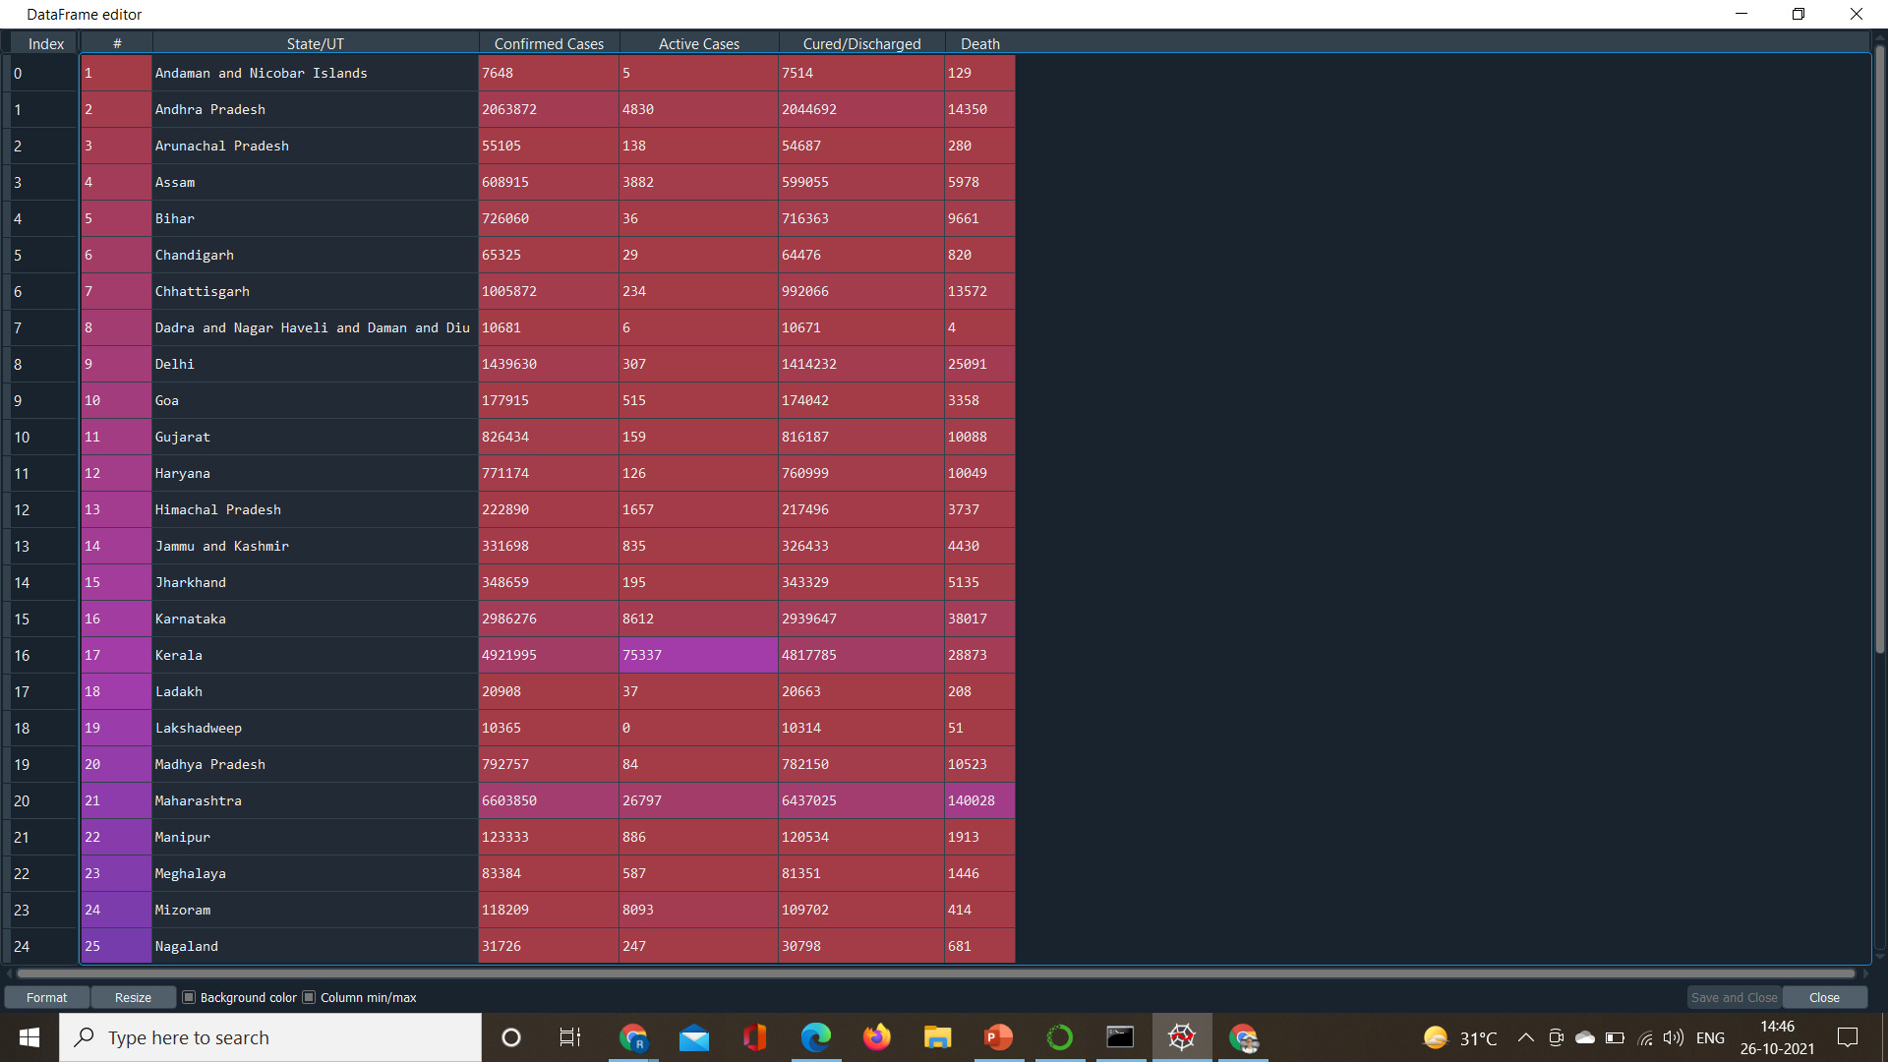
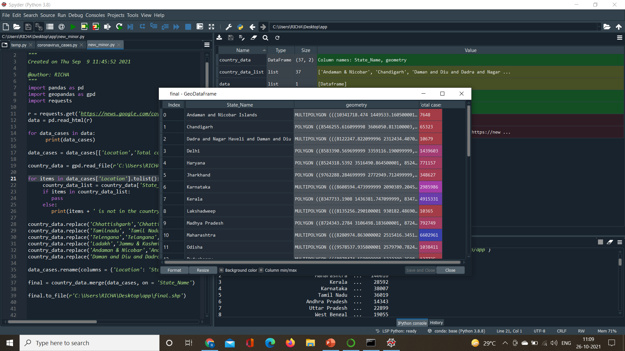
DATA REPESENTATION
Data of type list
GEODATAFRAME

Slide 23
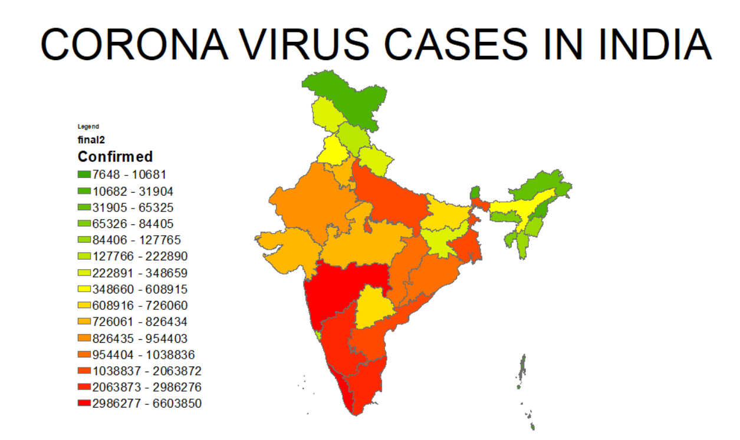
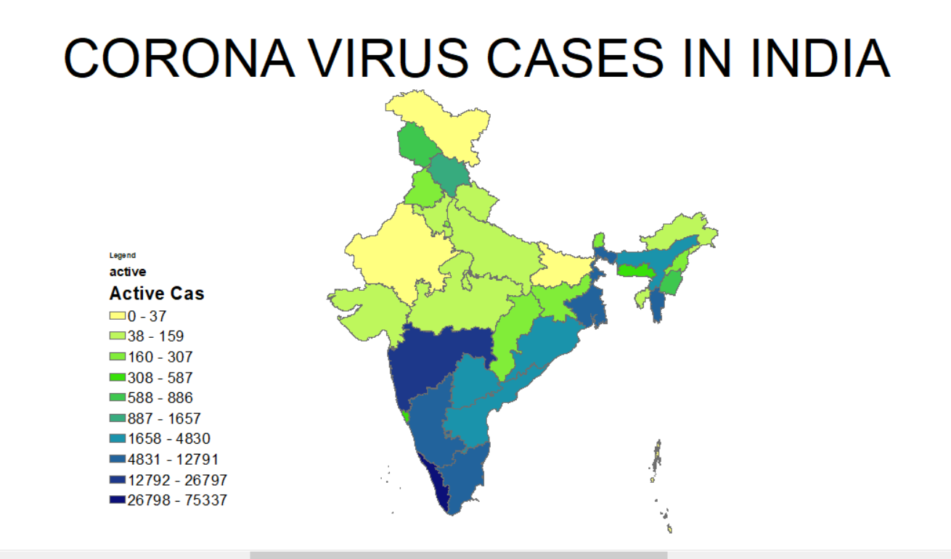
Result of Mapping using GIS
CONFIRMED CASES
ACTIVE CASES

Slide 24
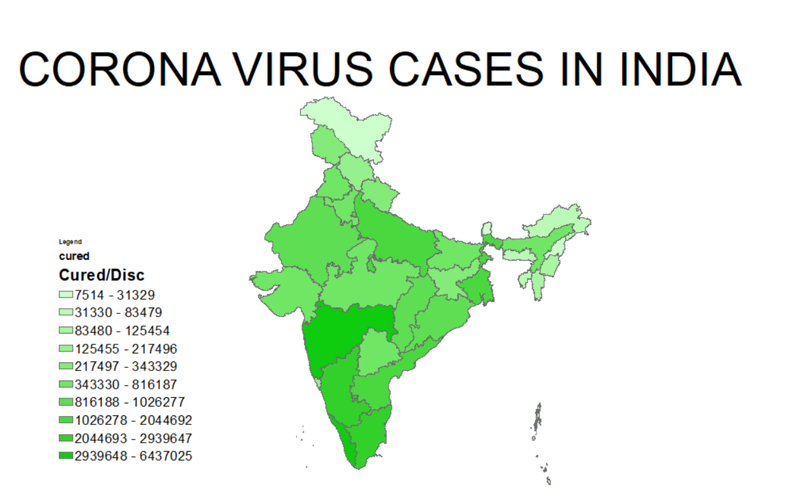
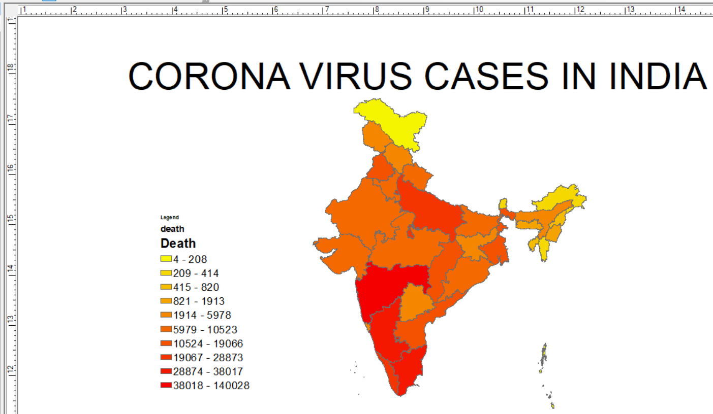
Result of Mapping using GIS
RECOVERED CASES
DEATH CASES

Slide 25
SPATIAL ANALYSIS OF CORONAVIRUS CASES
GIS is a new global health technology for mapping and tracking infectious disease patterns in space .
COVID-19 incidence is mapped. Spatial autocorrelation analysis (Moran's I index) is used to assess the distribution pattern of COVID-19. ^{[5]}
The primary hot locations are then identified using hot spot analysis.

Slide 26
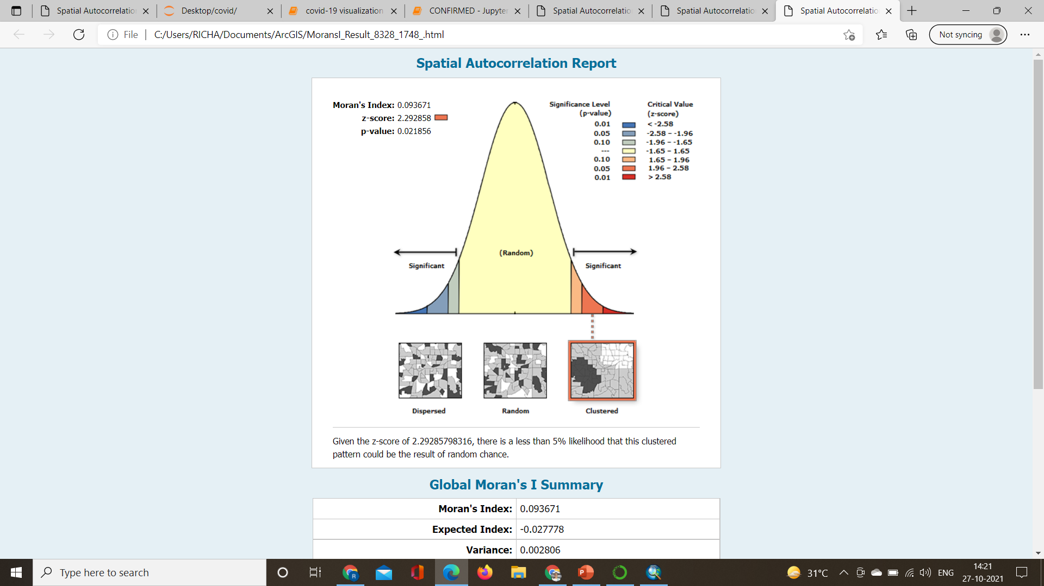
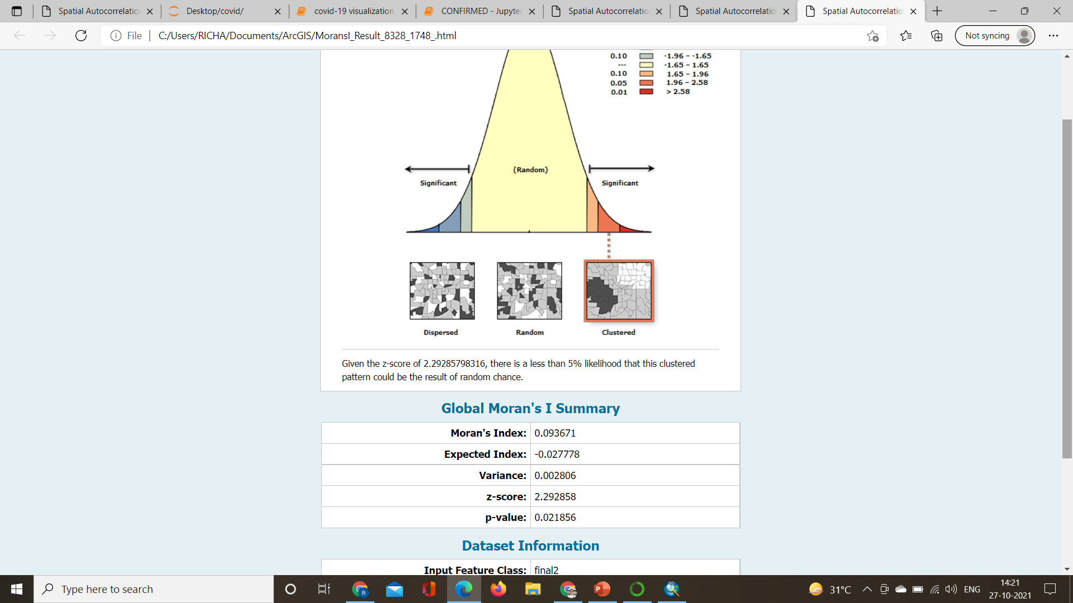
Spatial Autocorrelation(Morgan’S Index)
Morgan’s Index value in our case is 0.093671 which is positive and indicates tendency toward clustering.
The z-scores and p-values are measures of statistical significance which indicate whether the apparent similarity (a spatial clustering of either high or low values) or dissimilarity (a spatial outlier) is more pronounced.
We got both z and p value as positive which indicates that the surrounding features have similar values. ^{[6]}

Slide 27
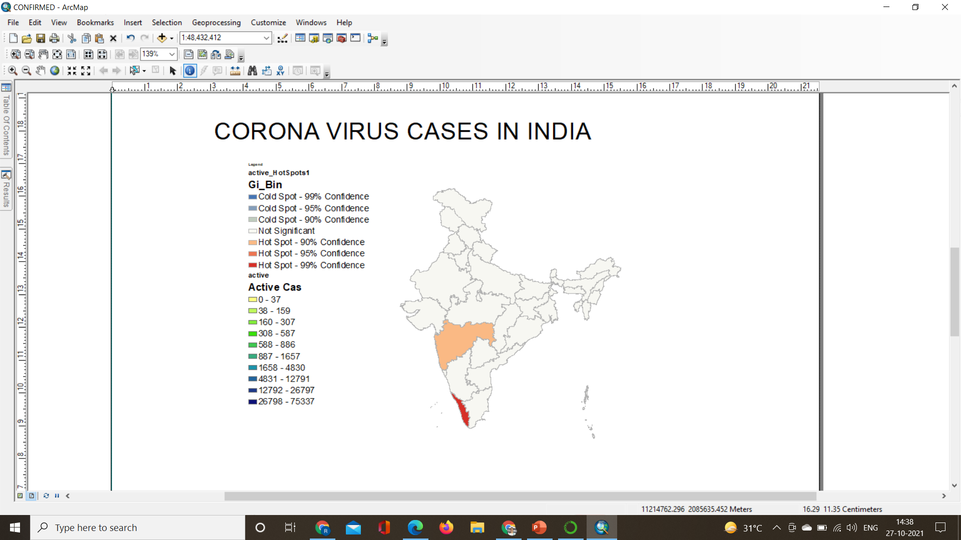
HOTSPOT ANALYSIS
First clustering is determined using Morgan’s Index.
Then on the basis of that hotspot analysis is performed.
Hot spots are areas that show statistically higher tendencies to cluster spatially.
This is determined by looking at each incident within the context of neighboring features. ^{[6]}

Slide 28
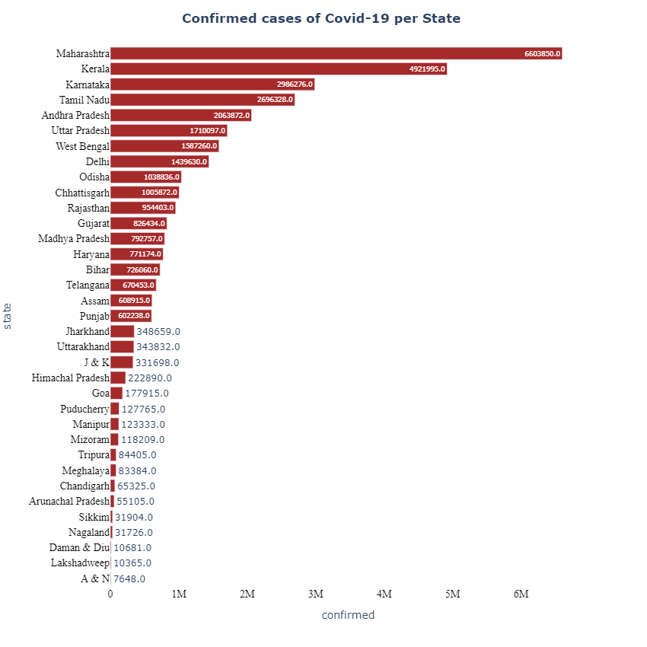
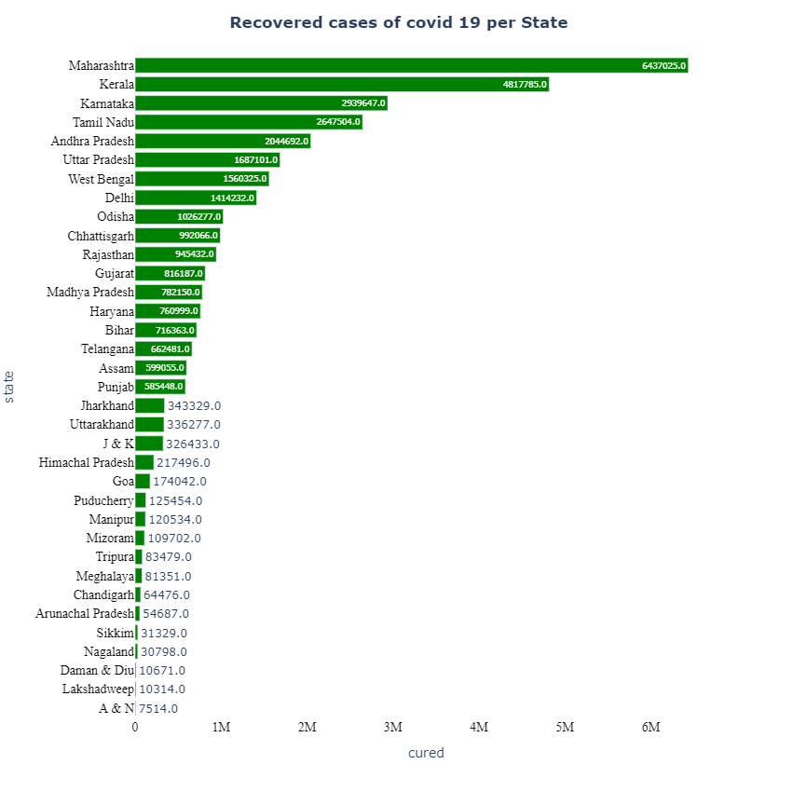
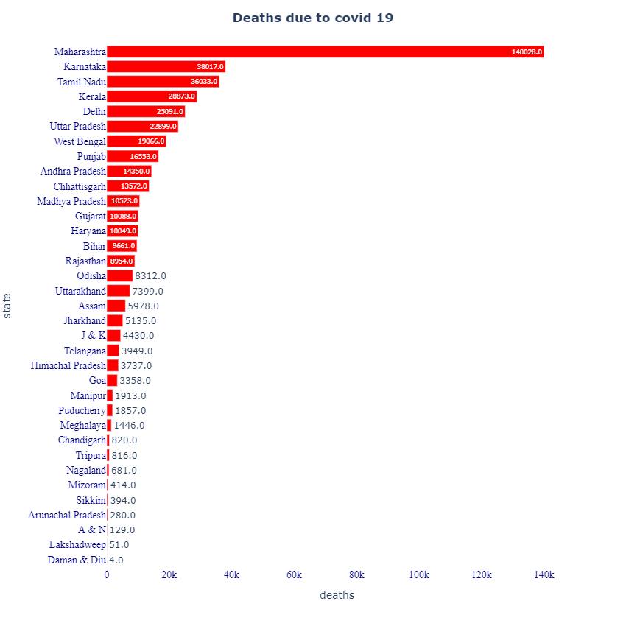
State Wise Analysis

Slide 29
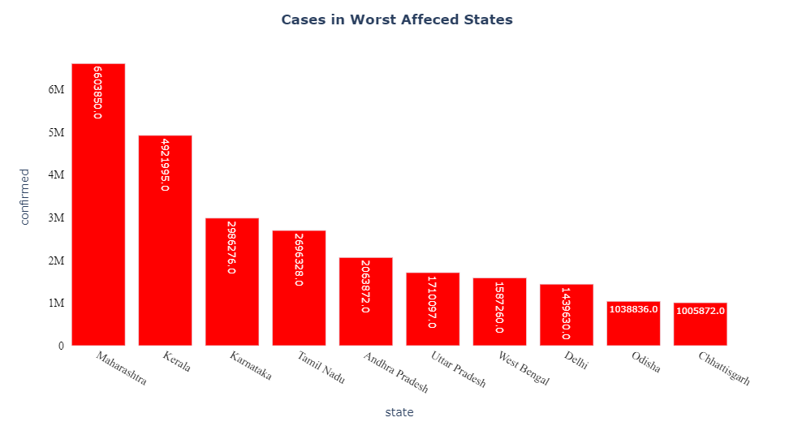
Cases In Worst Affected States

Slide 30
Proposed Model For COVID-19 Prediction
COVID-19 prediction is a time series forecasting which is the process of using a statistical model to predict future values of a time series based on past results^{[13]}.
The forecasting method has been used in this project is SARIMA.
Autoregressive Integrated Moving Average, or ARIMA, is one of the most widely used forecasting methods for univariate time series data forecasting.
An extension to ARIMA that supports the direct modeling of the seasonal component of the series is called SARIMA^{[13]}.

Slide 31
Time Series Components
Trend component
The trend is the long term pattern of a time series. A trend can be positive or negative depending on whether the time series exhibits an increasing long term pattern or a decreasing long term pattern. If a time series does not show an increasing or decreasing pattern then the series is stationary in the mean. ^{[16]}
Seasonal component
Seasonality occurs when the time series exhibits regular fluctuations during the same month (or months) every year, or during the same quarter every year. For instance, retail sales peak during the month of December. ^{[16]}
Irregular component
This component is unpredictable. Every time series has some unpredictable component that makes it a random variable. In prediction, the objective is to “model” all the components to the point that the only component that remains unexplained is the random component. ^{[16]}

Slide 32
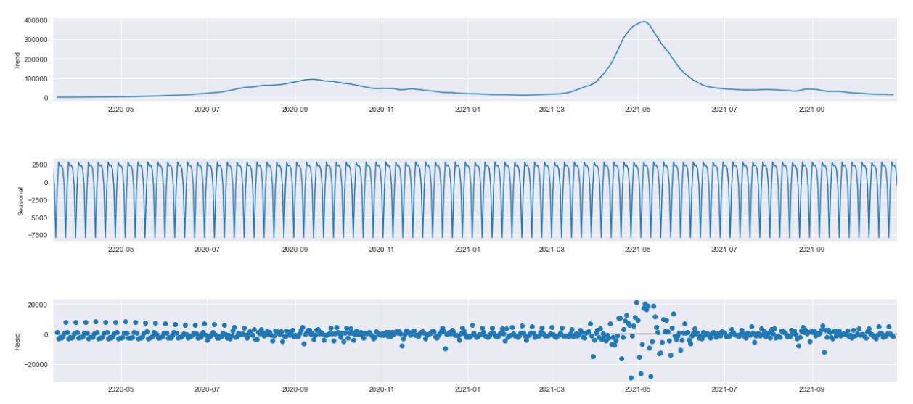
Time Series Components

Slide 33
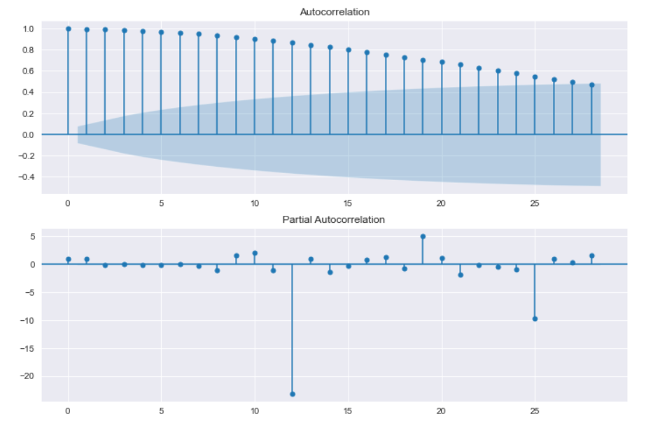
Steps Involved
Time series analysis cannot be done when data is not stationary.
We will first plot ACF and PACF when data is not stationary.
Here we see that our values are all exceeding the blue line. The goal is to have the values under the blue line, and they should be inverted as well.

Slide 34
ARIMA vs SARIMA
ARIMA
SARIMA
ARIMA(p, q, d) is a linear regression model on previous p values and previous q errors post differencing d times,
It is an extension of ARIMA, and has some additional seasonal parameters
Time series analysis can be done on stationary data and if data is not stationary then differencing operation is performed
Without using differencing operation , also we can make data stationary using SARIMA.
Differencing operation could not make data stationary so we did not use ARIMA
We used Sarima to make data stationary and make prediction.

Slide 35
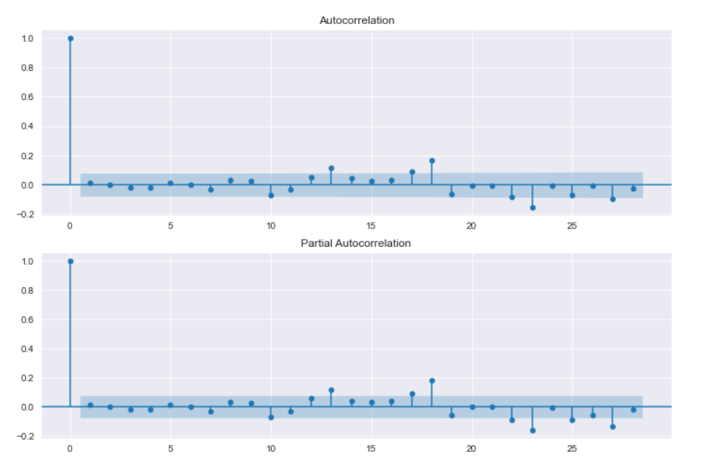
CONT….
To make the data stationary we can use differencing operation.
Differencing is a method of transforming a non-stationary time series into a stationary one. This is an important step in preparing data.We did not get any satisfactory result from it.
So, We used Sarima model to make the data stationary. ^{[12]}

Slide 36
Parameters of SARIMA Model
Trend elements
AR(p) Autoregression: Trend autoregression order -An auto regressive (AR(p)) component refers to the use of past values in the regression equation for the time series.The value in our case is 14.
I(d) Integration: Trend difference order- Uses differencing of observations (subtracting an observation from observation at the previous time step) in order to make the time series stationary. Differencing involves the subtraction of the current values of a series with its previous values d number of times. The value in our case is 1.
MA(q) Moving Average – a model that uses the dependency between an observation and a residual error from a moving average model applied to lagged observations. A moving average component depicts the error of the model as a combination of previous error terms. The order q represents the number of terms to be included in the model^{[16]}.

Slide 37
CONT…
Seasonal Elements
P: Seasonal autoregressive order.
D: Seasonal difference order.
Q: Seasonal moving average order.
m: The number of time steps for a single seasonal period.
We have not initialized Seasonal elements as covid-19 is not yet discovered as a seasonal disease.
The notation of Sarima Model is SARIMA(p,d,q)(P,D,Q)m
Forecasting Equation :- ŷ_{t} = μ + ϕ₁ y_{t-1} +…+ ϕ_{p} y_{t-p} - θ₁e_{t-1} -…- θ_{q}e_{t-q}
where: Ф, φ, Θ and θ represents the seasonal and non-seasonal components parameters of autoregressive AR and moving average MA respectively; B = backward operator, B(yt) = yt–1; (1–BS)D = Dth seasonal difference of season s; (1 – B)d = dth non-seasonal difference; εt = an independently distributed random variable; P and p represents the orders of the AR components; Q and q represents the orders of MA components; D and d are difference terms. ^{[20]}

Slide 38

Steps to Use SARIMA Model
Define Model
An instance of the SARIMAX class can be created by providing the training data and a host of model configuration parameters
Fit Model
Once the model is created, it can be fit on the training data.
The model is fit by calling the fit() function below.

Slide 39
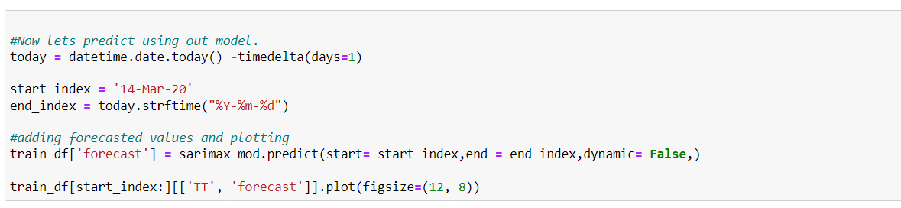
CONT….
Make Prediction
Once fit, the model can be used to make a forecast.
A forecast can be made by calling the forecast() or the predict() functions on the SARIMAXResults object returned from calling fit.
The predict() function requires a start and end date or index to be specified.

Slide 40
Output
Date | Actual cases
2021-11-10 | 13091
2021-11-11 | 12516
2021-11-12 | 11850
2021-11-13 | 11271
2021-11-14 | 10229
2021-11-15 | 8865
2021-11-16 | 10197
2021-11-17 | 11919
Date | Predicted cases
2021-11-10 | 13491.5917
2021-11-11 | 12023.1579
2021-11-12 | 11681.4144
2021-11-13 | 11341.9317
2021-11-14 | 10966.7678
2021-11-15 | 9347.34554
2021-11-16 | 10988.3295
2021-11-17 | 12815.9793
The accuracy of our model obtained is 95.3763% and is calculated by the formula 1-(abs(x-y)/x)*100 , Where x represents actual case and y represents predicted case.

Slide 41
CONCLUSION
We got to learn about geographic information system which is a computer system for capturing, storing,checking, and displaying data related to positions on Earth’s surface. and its various application.
Using GIS capabilities such as spatial analytics, mapping, helped to understand how the infection is spreading out and in what areas immediate actions are required.
To predict the CoronaVirus cases, Sarima model has been used.Firstly the time series analysis is performed to check the trend in data .
Then ACF and PACF are being plotted to check if data is stationary,The data was not stationary ,then differencing was used to make it stationary,but we couldnot achieve using it,then Sarmia model is fitted and result is predicted.
The accuracy that we got in our project is 95.37%.

Slide 42
REFERENCES
1. Perumal, Mousi & Velumani, Bhuvaneswari & Sadhasivam, Ananthi & Ramasami, Kalpana. (2015). Spatial Data Mining approaches for GIS – A brief review. Advances in Intelligent Systems and Computing. 338. 10.1007/978-3-319-13731-5_63.
2. Goyal, Hemlata & Sharma, Chilka & Joshi, Nisheeth. (2017). An Integrated Approach of GIS and Spatial Data Mining in Big Data. International Journal of Computer Applications. 169. 1-6. 10.5120/ijca2017914012.
3.Malki, Z., Atlam, ES., Ewis, A. et al. ARIMA models for predicting the end of COVID-19 pandemic and the risk of second rebound. Neural Comput & Applic 33, 2929–2948 (2021). https://doi.org/10.1007/s00521-020-05434-0
4. Nasim Tohidi and Rustam B. Rustamov, Review of the Machine Learning in GIS for Megacities Application, 2020 October, DOI: 10.5772/intechopen.94033
5.Yao, Y., Shi, W., Zhang, A. et al. Examining the diffusion of coronavirus disease 2019 cases in a metropolis: a space syntax approach. Int J Health Geogr 20, 17 (2021).
6.Adiatna, Puji & Murad, Abdulkader. (2017). Reviewing the use of Geographic Information System (GIS) to measure Sustainable Urban Transport performance. Journal of Geoscience, Engineering, Environment, and Technology. 2. 171. 10.24273/jgeet.2017.2.2.345.
7.Davis, Frank W. et al. “Environmental analysis using integrated GIS and remotely sensed data - Some research needs and priorities.” Photogrammetric Engineering and Remote Sensing 57 (1991): 689-697.
8.Shankar, Hari & Ray, P.K.. (2021). GIS-Based Analysis of COVID-19 Cases in India during Pre-lockdown, Lockdown and Unlock Phases. International Journal of Infectious Diseases. 105. 10.1016/j.ijid.2021.02.070.

Slide 43
9.Paolo Burlando, Renzo Rosso, Luis G. Cadavid, Jose D. Salas, Forecasting of short-term rainfall using ARMA models, Journal of Hydrology,Volume 144, Issues 1–4,1993,Pages 193-211,ISSN 0022-1694.
10. F. Kadri, F. Harrou and Y. Sun, "A multivariate time series approach to forecasting daily attendances at hospital emergency department," 2017 IEEE Symposium Series on Computational Intelligence (SSCI), 2017, pp. 1-6, doi: 10.1109/SSCI.2017.8280850.
11. Rahman, Md. Habibur & Salma, Umma & Hossain, Md & Khan, Md Tareq Ferdous. (2016). Revenue Forecasting using Holt–Winters Exponential Smoothing. Research & Reviews: Journal of Statistics. 5. 19-25.
12. Niematallah Elamin, Mototsugu Fukushige,Modeling and forecasting hourly electricity demand by SARIMAX with interactions,Energy,Volume 165, Part B,018,Pages 257-268,ISSN 0360-5442,
13. Xiaogian Wang, Yenfei Kang, Rob J Hyndman, Feng Li, Distributed ARIMA Models for Ultra-long Time Series arXiv:2007.09577 [stat.AP]
14. Franch-Pardo, Ivan; Napoletano, Brian M.; Rosete-Verges, Fernando; Billa, Lawal (2020). Spatial analysis and GIS in the study of COVID-19. A review. Science of The Total Environment, 739(), 140033–. doi:10.1016/j.scitotenv.2020.140033
15. Demir, Ibrahim & Kirişci, Murat. (2021). Forecasting COVID-19 disease cases using the SARIMA-NNAR hybrid model. 10.1101/2021.04.26.21256108.
16.Singh, S., Chowdhury, C., Panja, A.K. et al. Time Series Analysis of COVID-19 Data to Study the Effect of Lockdown and Unlock in India. J. Inst. Eng. India Ser. B 102, 1275–1281 (2021). https://doi.org/10.1007/s40031-021-00585-7
17. V. Poleneni, J. K. Rao and S. Afshana Hidayathulla, "COVID-19 Prediction using ARIMA Model," 2021 11th International Conference on Cloud Computing, Data Science & Engineering (Confluence), 2021, pp. 860-865, doi: 10.1109/Confluence51648.2021.9377038.
18. https://prsindia.org/covid-19/cases.
19. https://www.igismap.com/download-india-boundary-shapefile-free-states-boundary-assembly-constituencies-village-boundaries/
20. Christophorus Beneditto Aditya Satrio, William Darmawan, Bellatasya Unrica Nadia, Novita Hanafiah,Time series analysis and forecasting of coronavirus disease in Indonesia using ARIMA model and PROPHET,Procedia Computer Science,Volume 179,2021,
Pages 524-532,ISSN 1877-0509

Slide 44
THANK YOU!

